Slide 1
August 10, 2023 Blight

Slide 2
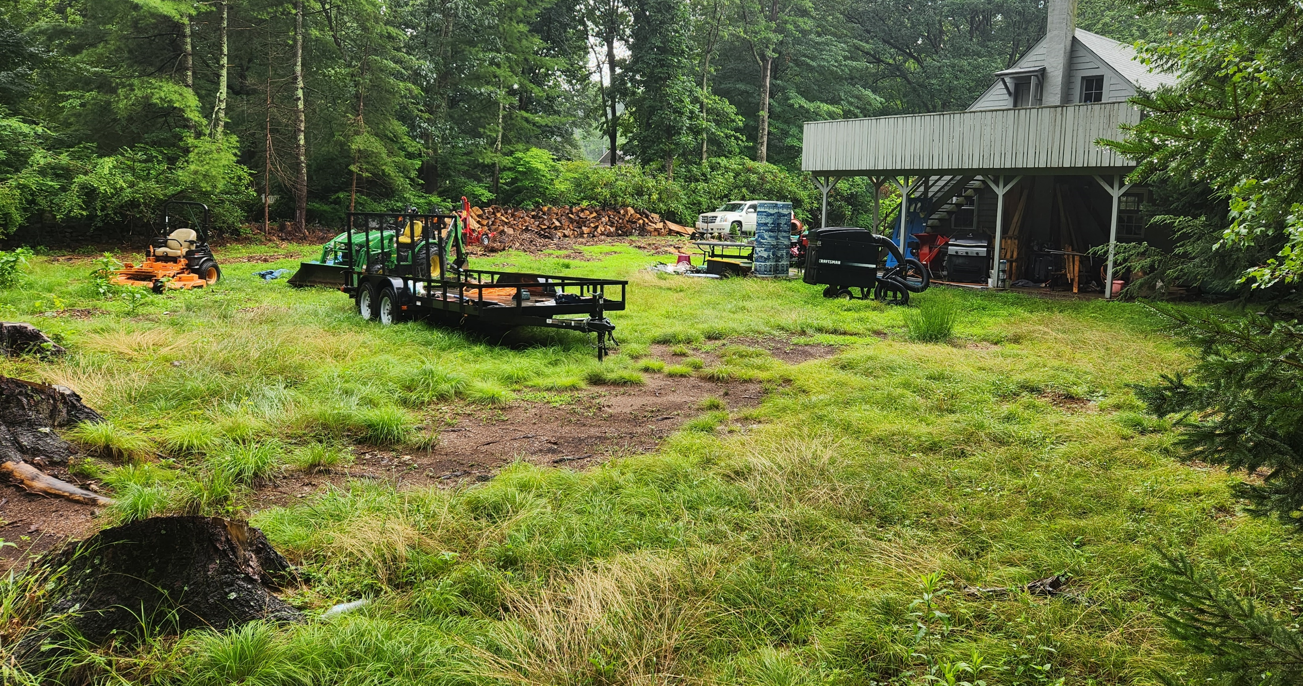
164 Newtown Turnpike

Slide 3
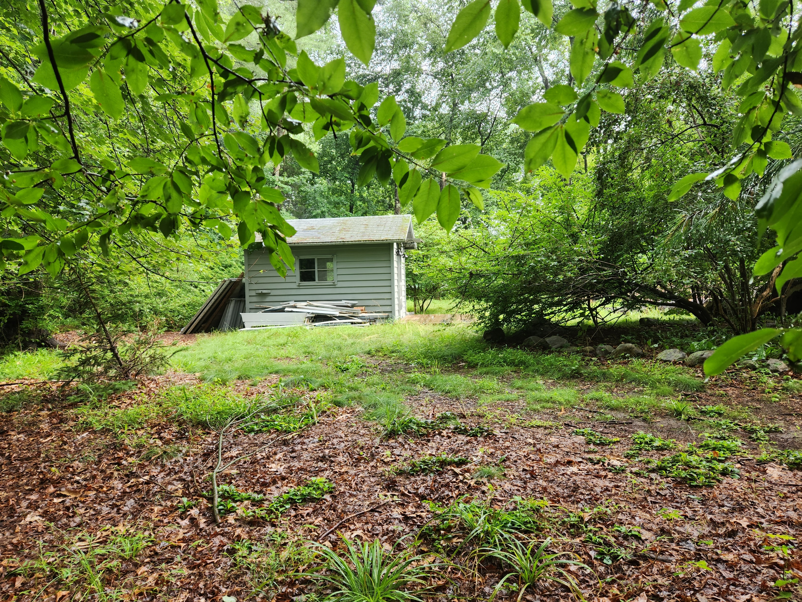
164 Newtown Turnpike

Slide 4
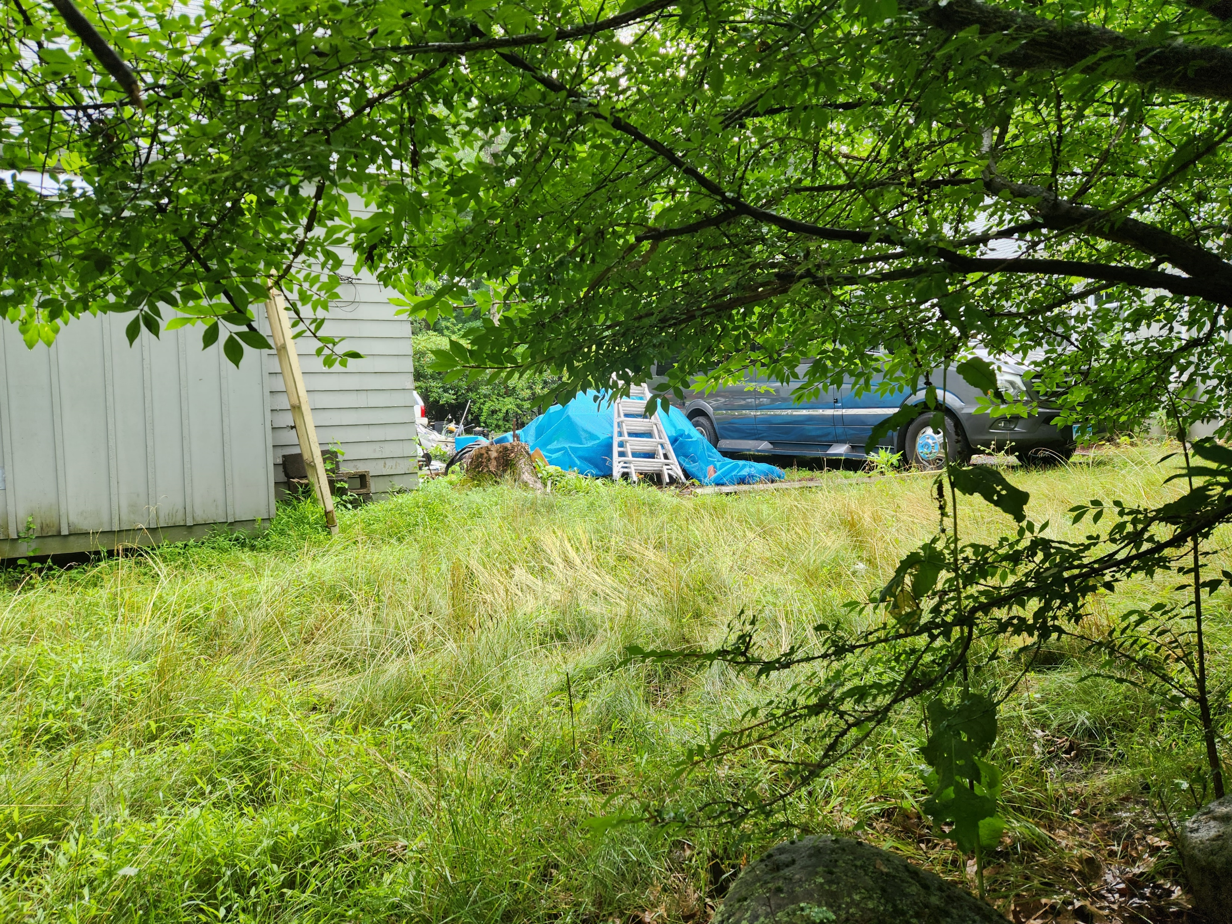
164 Newtown Turnpike

Slide 5
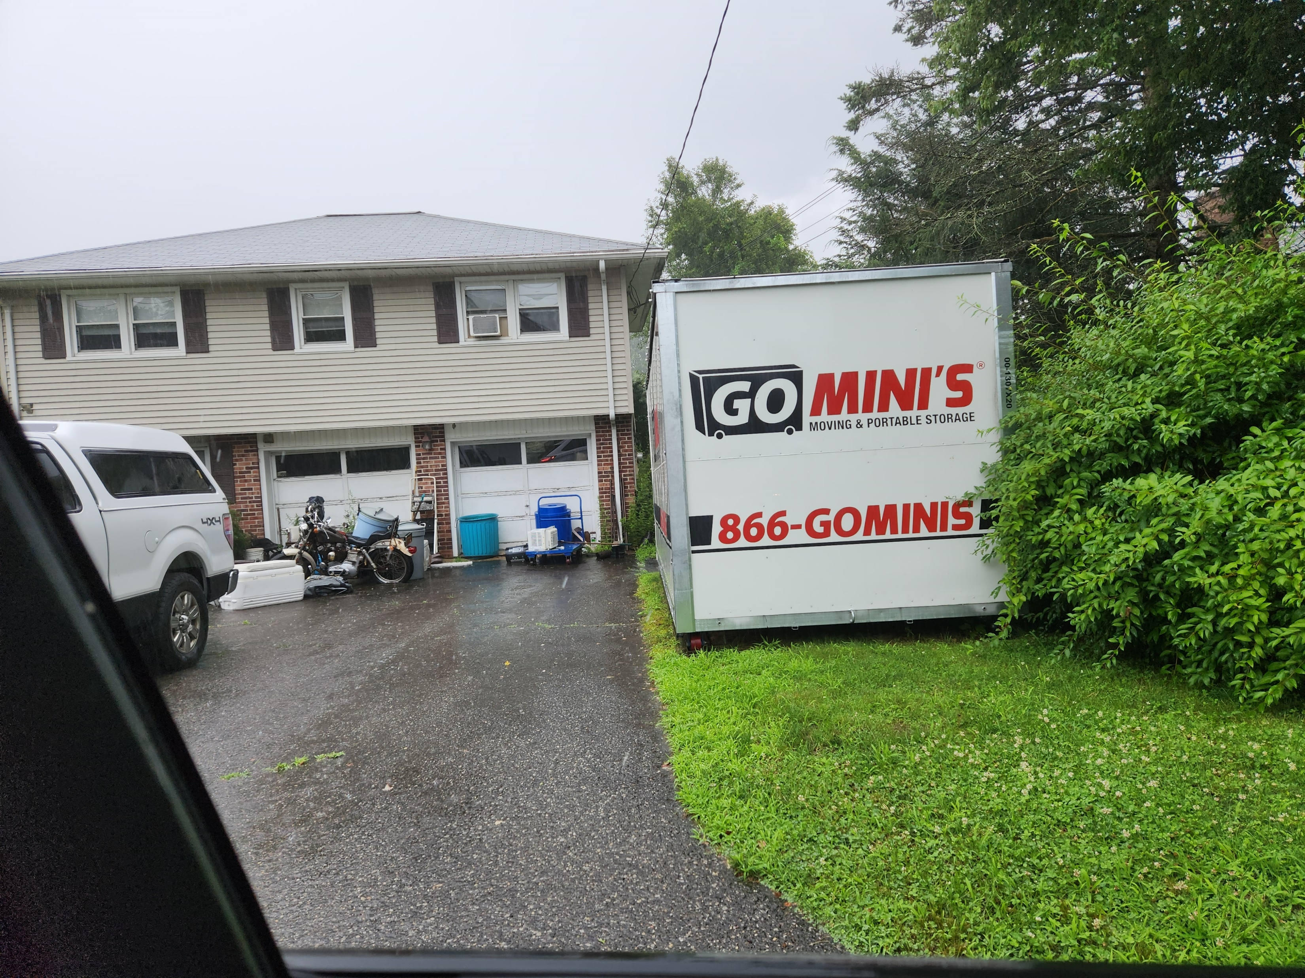
8 Palmieri Rd

