Slide 1
Tarpon Towers II, LLC and
New Cingular Wireless PCS, LLC (“AT&T”)
CT1024 92 Greens Farms Road
Westport, CT
Municipal Consultation Public Meeting

Slide 2
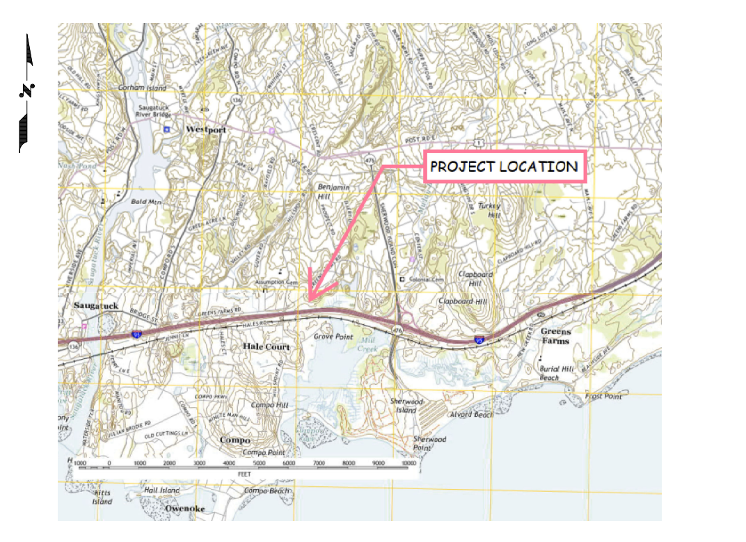
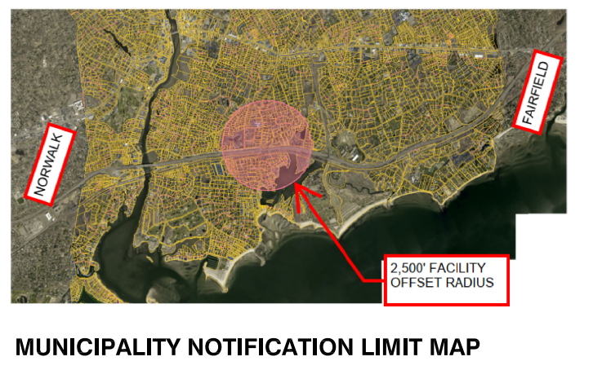
Vicinity and Notification Maps

Slide 3
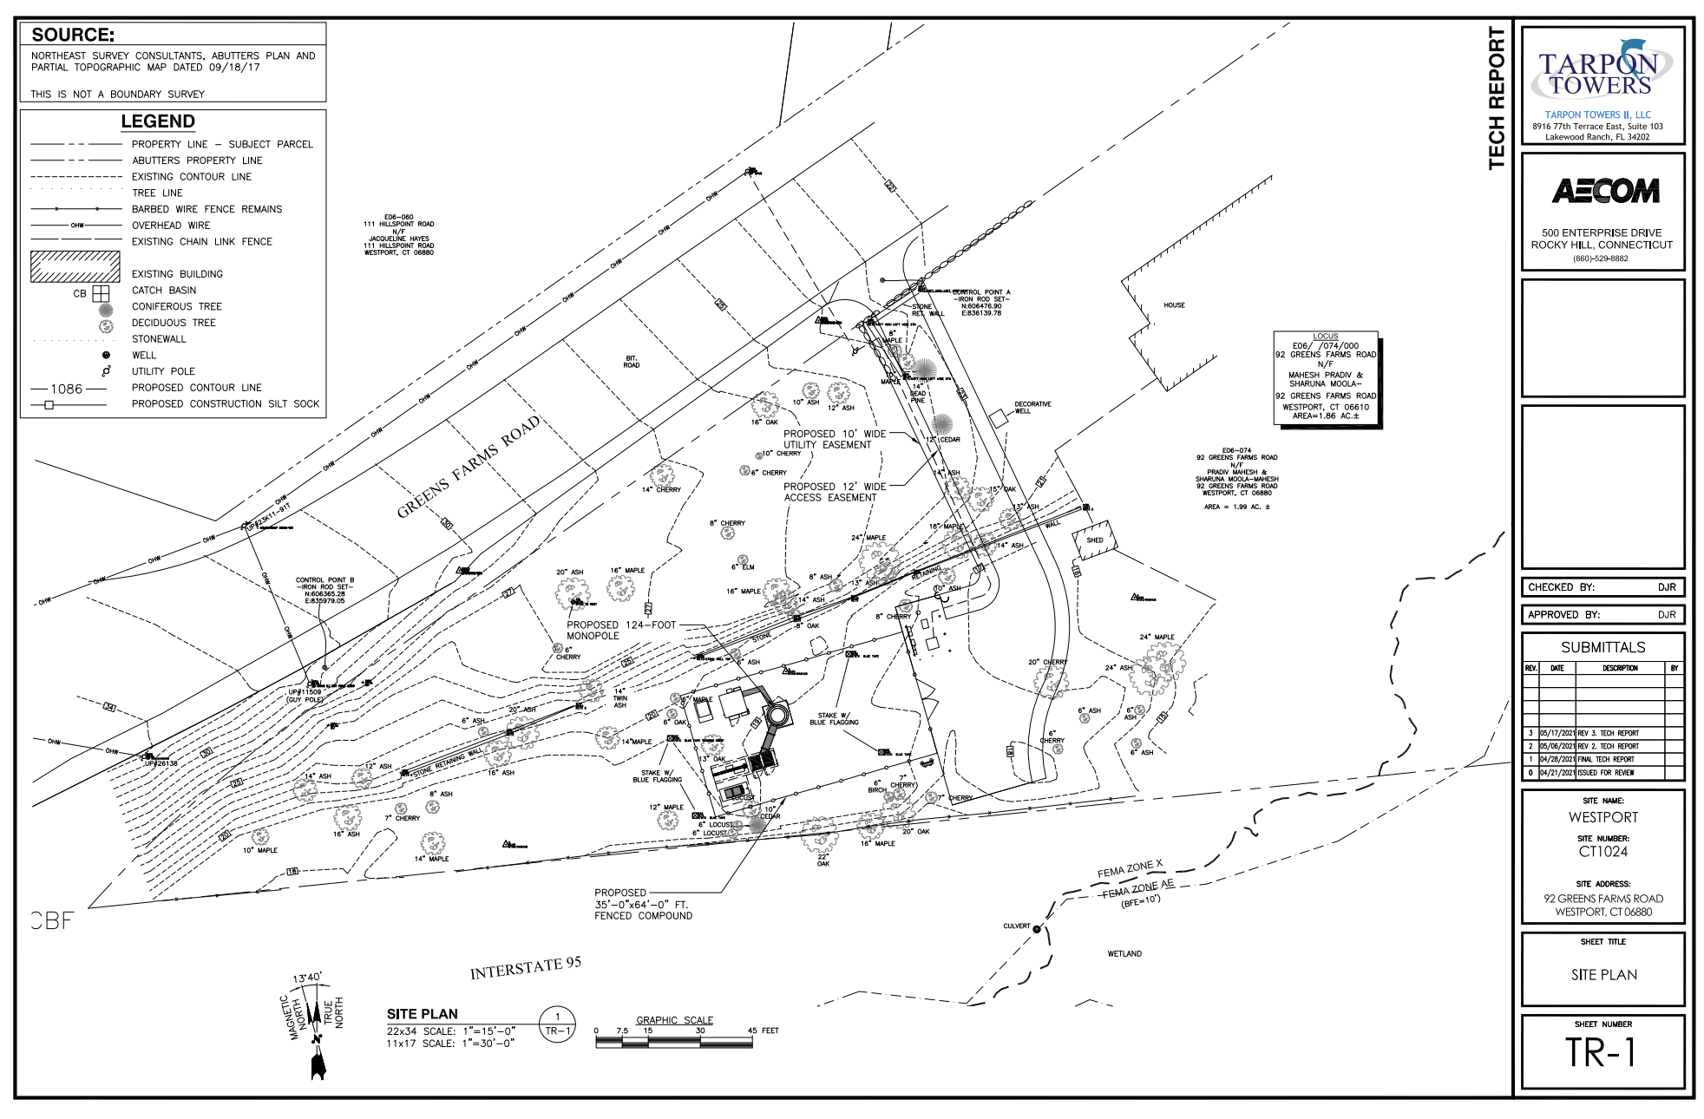
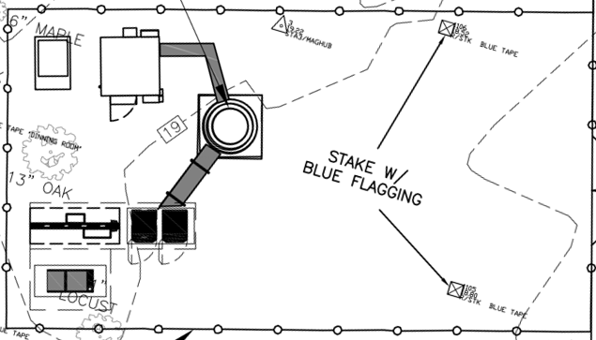
Site Plan

Slide 4
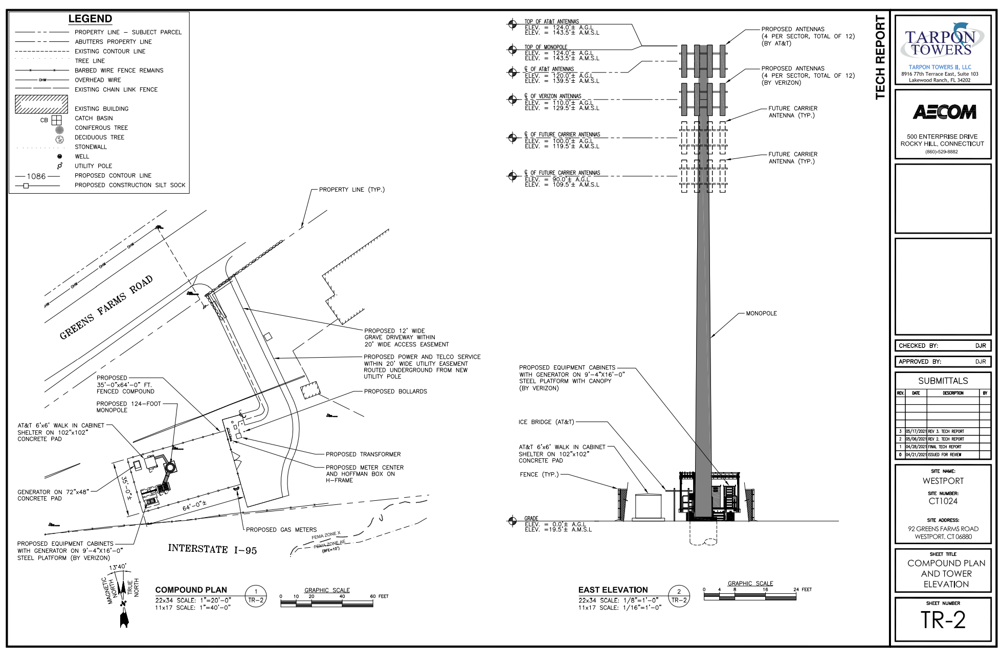
Elevation

Slide 5
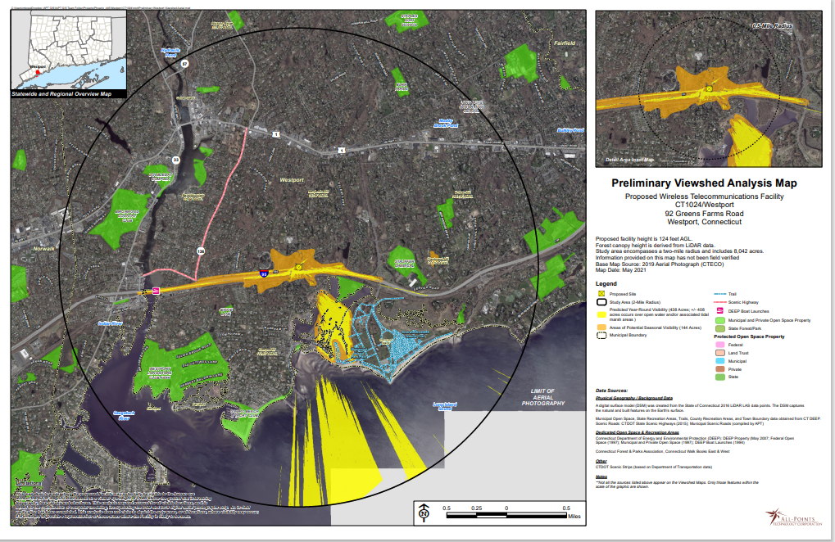
Preliminary Viewshed Analysis Map

Slide 6
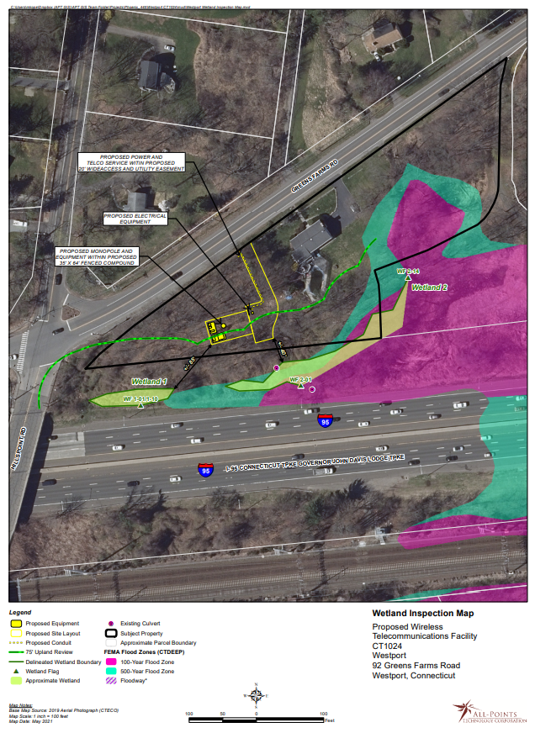
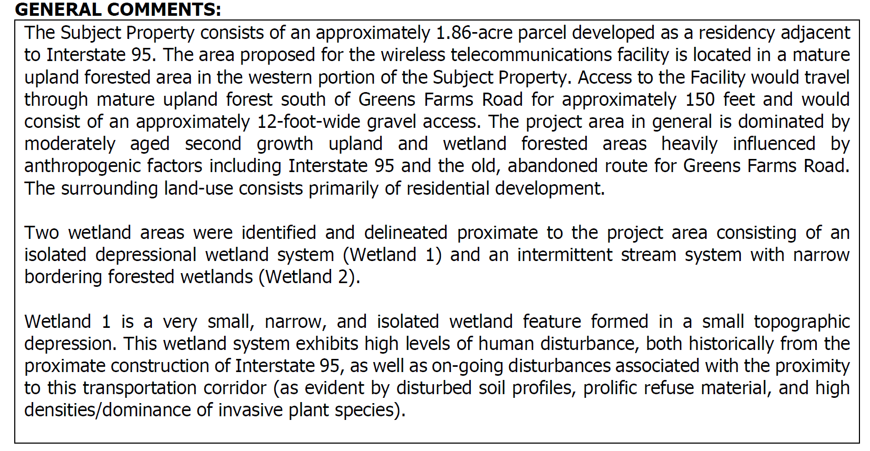
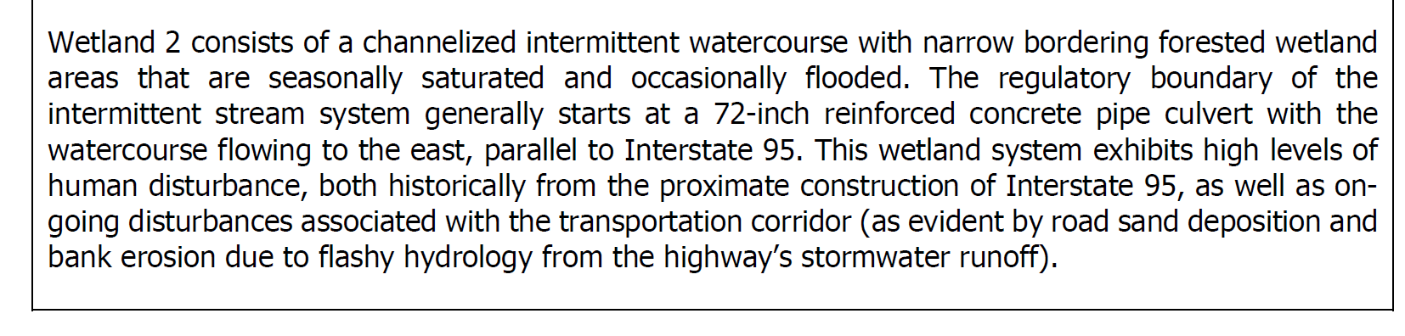
Wetlands Map and Summary

Slide 7
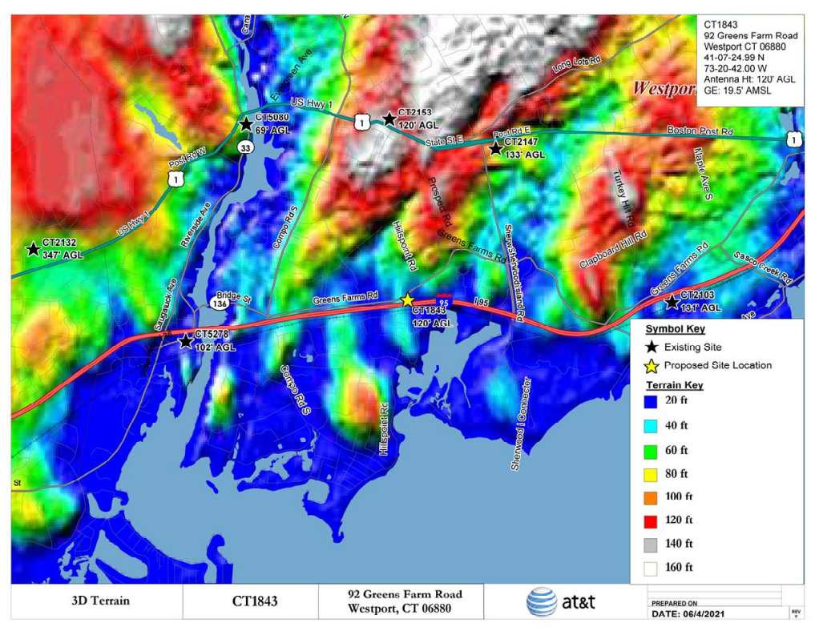
Area Terrain Map

Slide 8
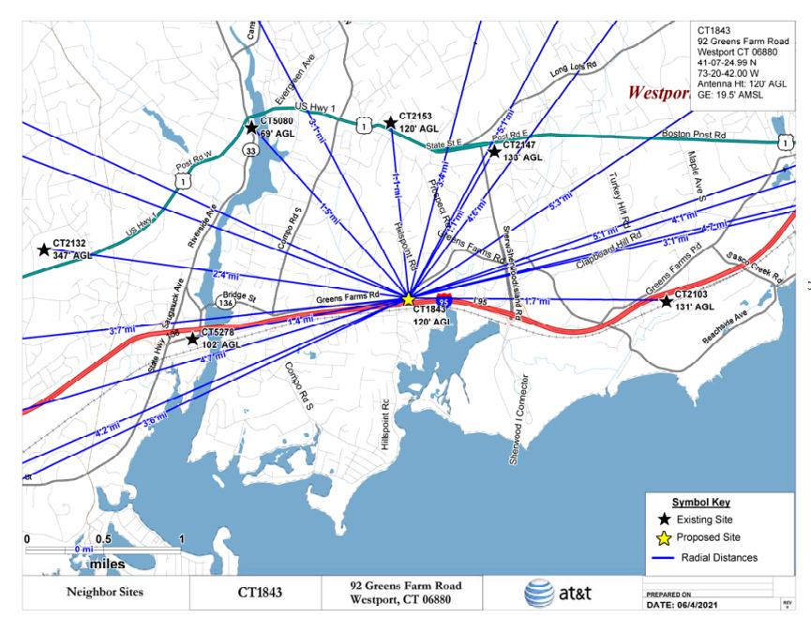
AT&T Neighbor Sites and Distance

Slide 9
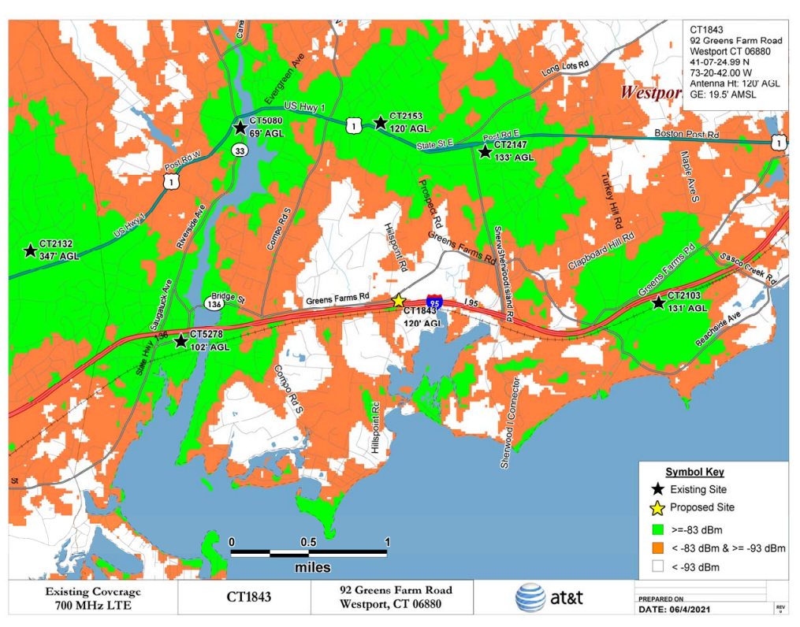
AT&T Existing 700MHz LTE Coverage

Slide 10
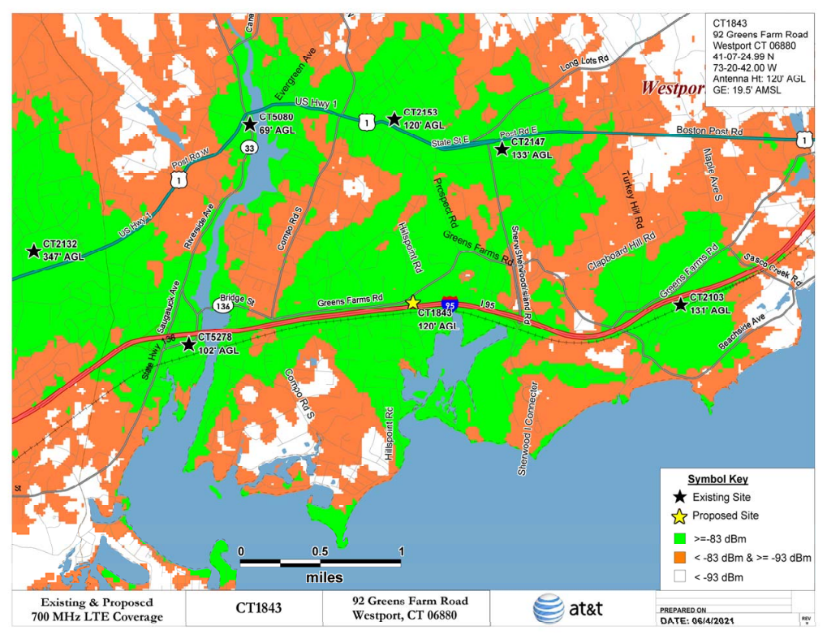
AT&T Proposed 700MHz LTE Coverage

