Slide 2
August 20, 2020
Blight Prevention Board

Slide 3
1 Twin Oaks Lane

Slide 4
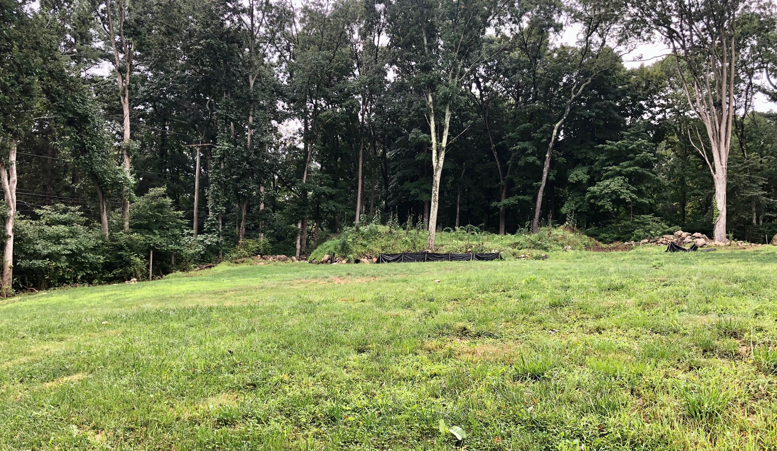

Slide 5
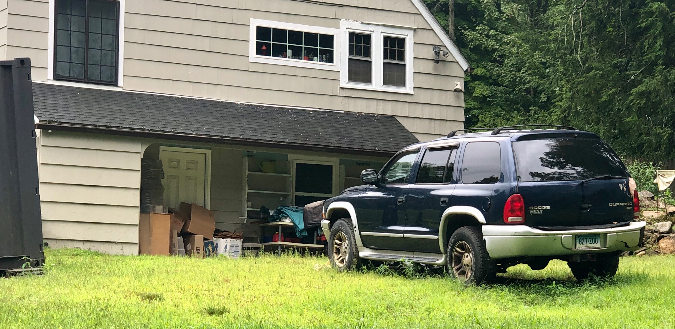

Slide 6
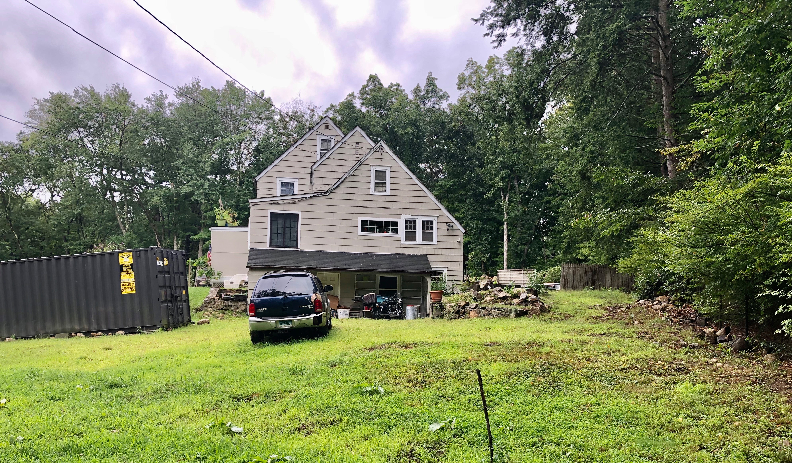

Slide 7
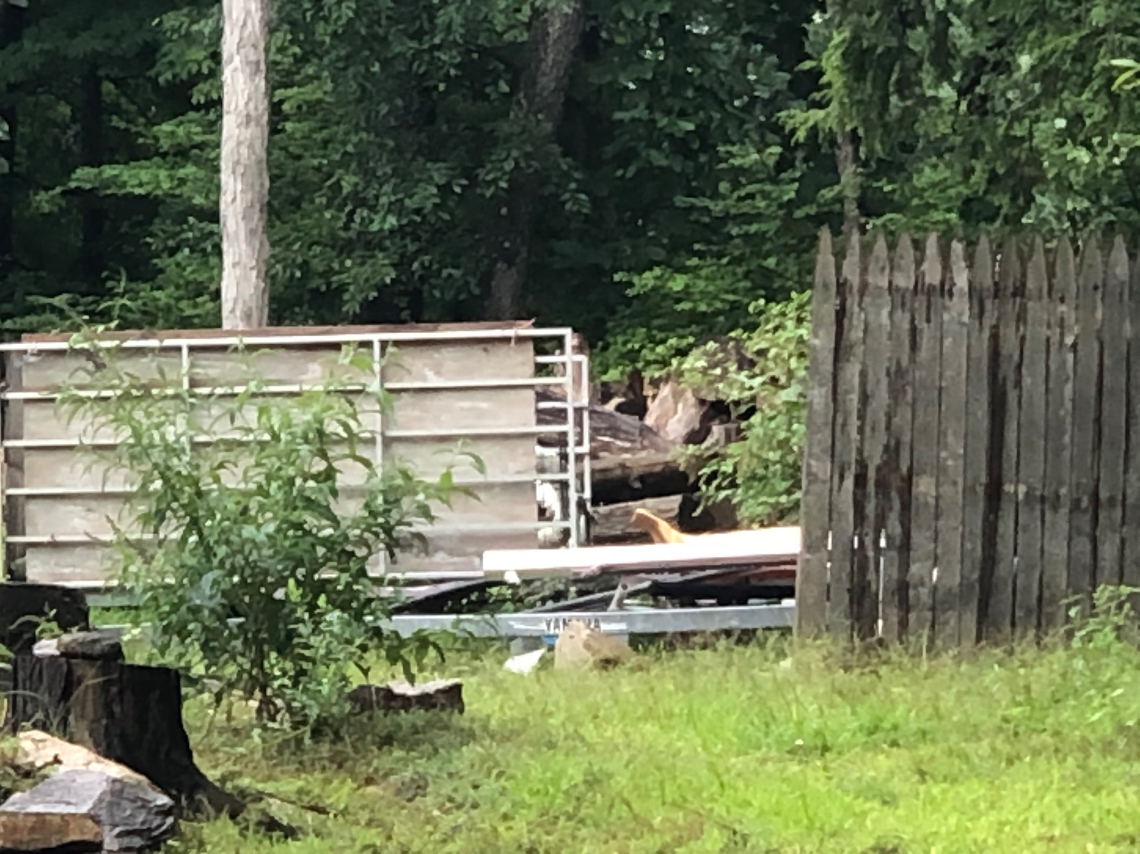

Slide 8
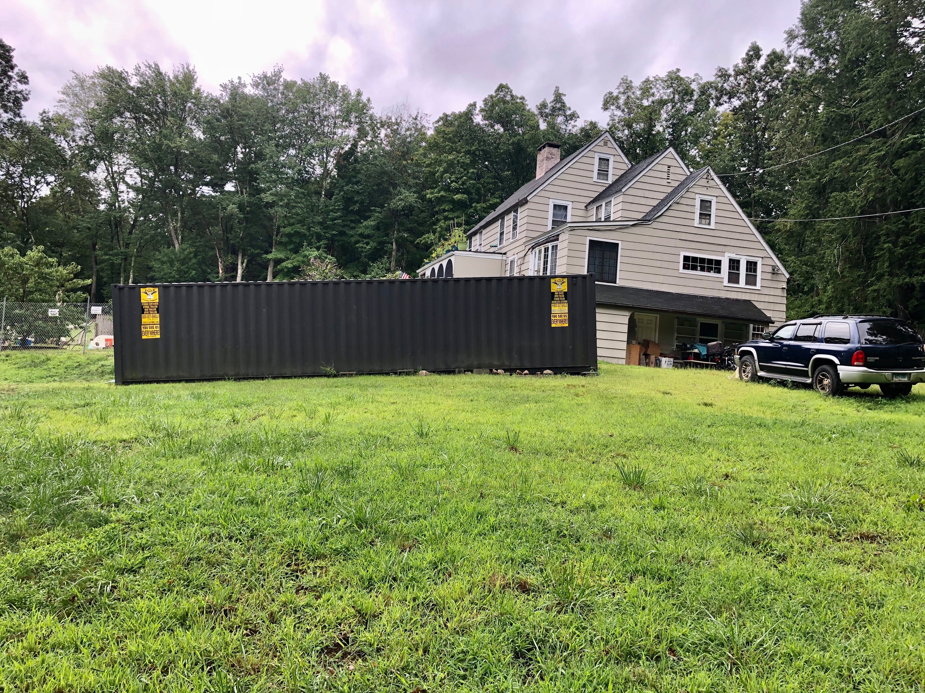

Slide 9
